Slide 1
Aircraft Traffic Control with Reinforcement Learning
*A project for the course DSE 314: Reinforcement Learning
Akash Kumar Singh
Roll No.: 19023
Department: Data Science and Engineering
Alli Khadga Jyoth
Roll No.: 19024
Department: Data Science and Engineering
Indian Institute of Science Education and Research Bhopal

Slide 2
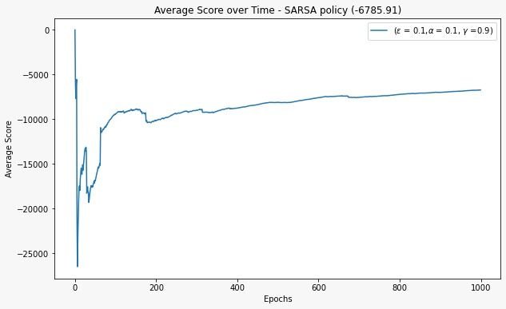
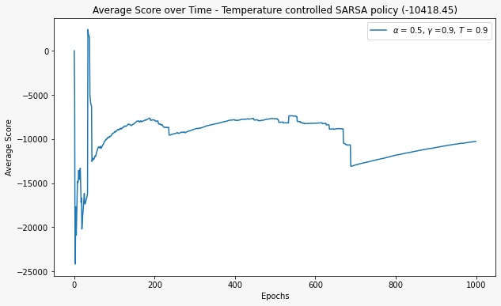
In this project, we employed a reinforcement learning approach to create an aircraft collision avoidance system that is comparable to what is used in air traffic control. We modeled our agent as an MDP running a SARSA algorithm. In comparison to our baseline agents, our SARSA + Greedy agent was able to avoid collisions with reasonable success. After learning from its first episodes, our RL agent continually improved its results.
We implemented our algorithm for both single destination and multiple destination airports. For SARSA we used both Constant Temperature SARSA and Temperature Controlled Exploration. For baseline agents which is used for comparison with our agent are Random Policy Agent and Straight Line Following Greedy Agent. The below figures show the Average Score vs no. of episodes for each agents.
Our agents (SARSA+Greedy)
Single destination with Constant Temperature SARSA
Single destination with Temperature Controlled Exploration

Slide 3
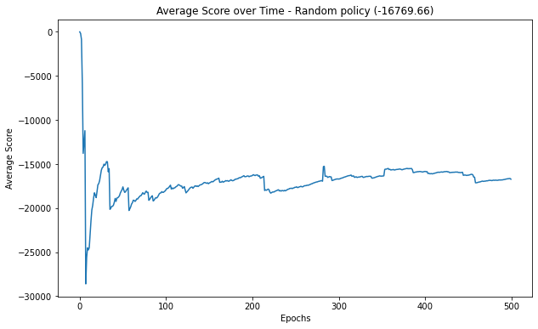
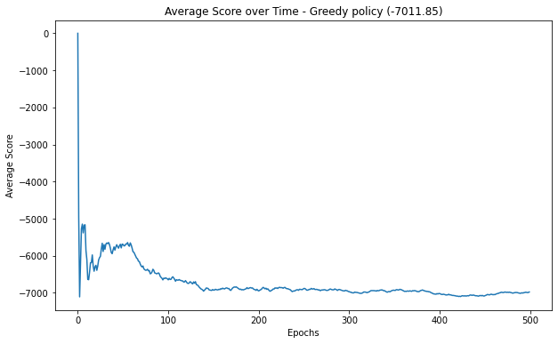
Baseline agents
Random Policy Agent
Straight Line Following Greedy Agent

Slide 4
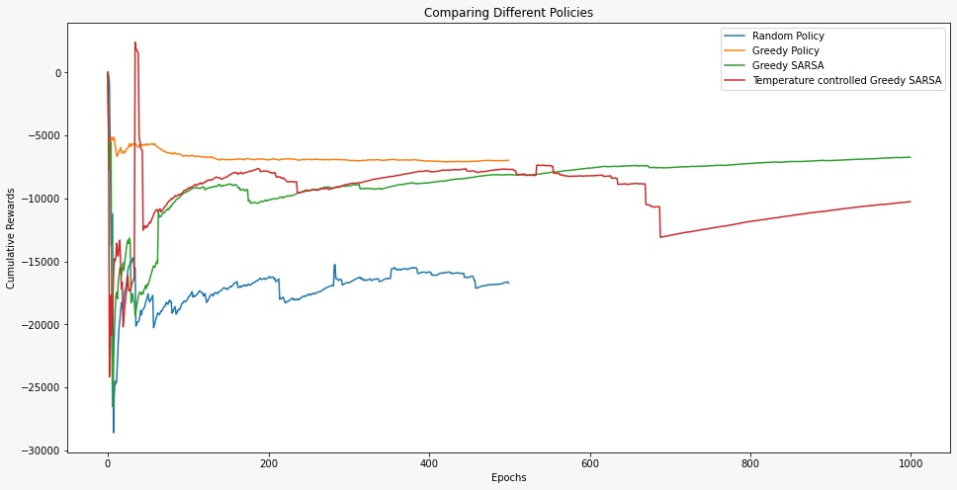
comparison between all the agents

Slide 5
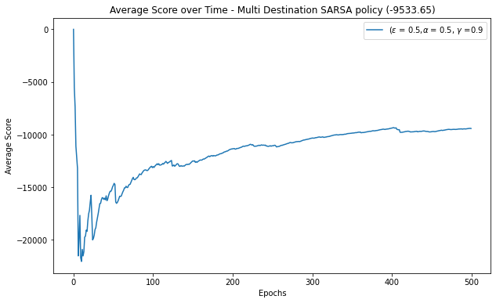
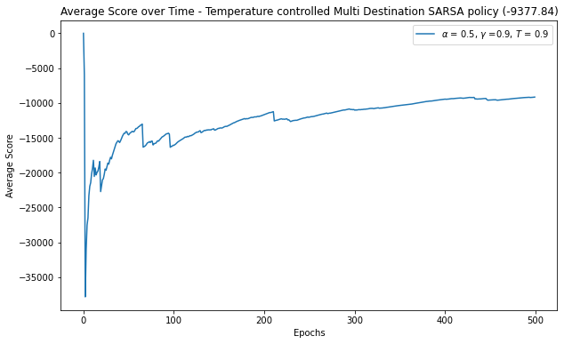
Our agents (SARSA+Greedy) for multiple destinations
Multiple destinations with Constant Temperature SARSA
Multiple destinations with Temperature Controlled Exploration
THE END !!

